Slide 1
Mechanical Design of Robots

Slide 2
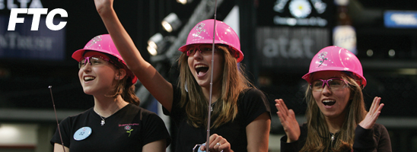
High School Competitions

Slide 3
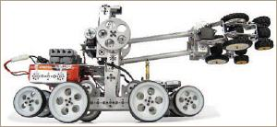
Show of Tetrix robot built by Pitsco

Slide 4
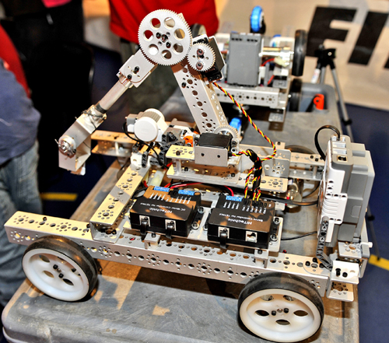
Mobile base with two controlled wheels and the arm, see use of gears.

Slide 5
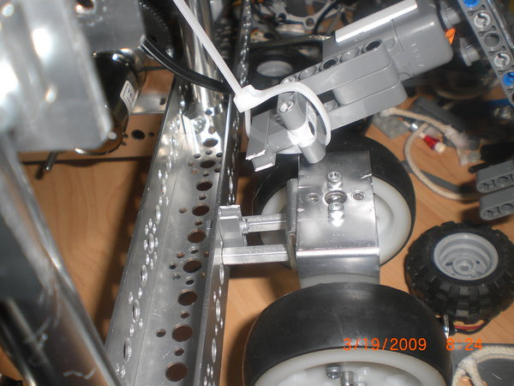
Attachment of components.

Slide 6
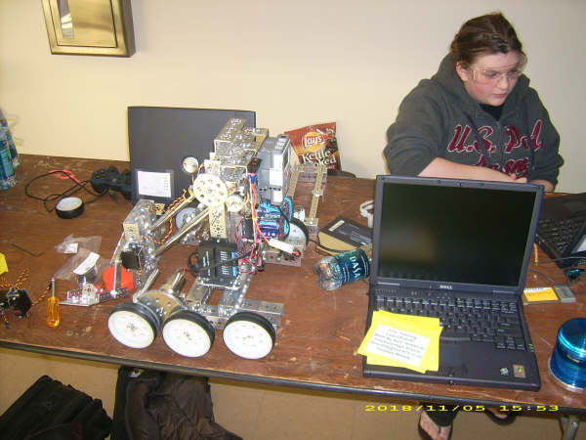
Three wheels on each side, but only one or two may be controlled. They can be also geared together
Arm with parallelogram

Slide 7
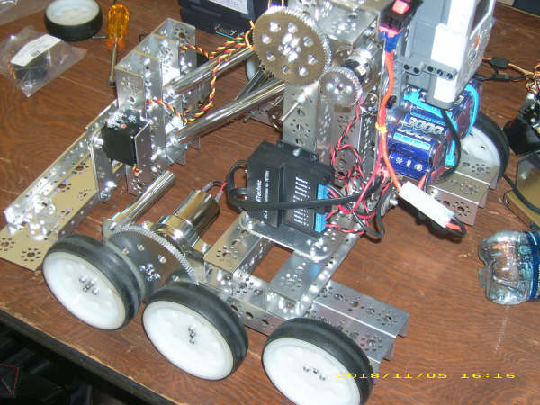
Robot with 6 wheels controlled by 2 DC motors

Slide 8
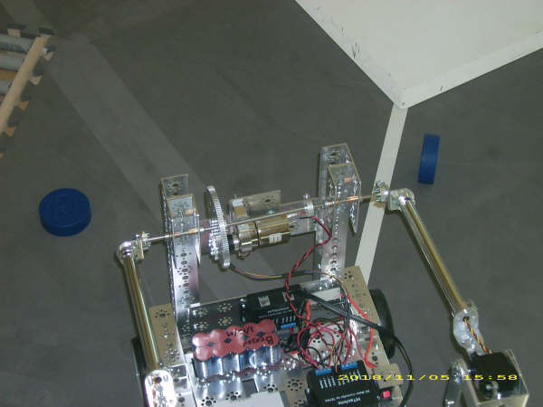
Arm construction. Batteries located on robot.

Slide 9
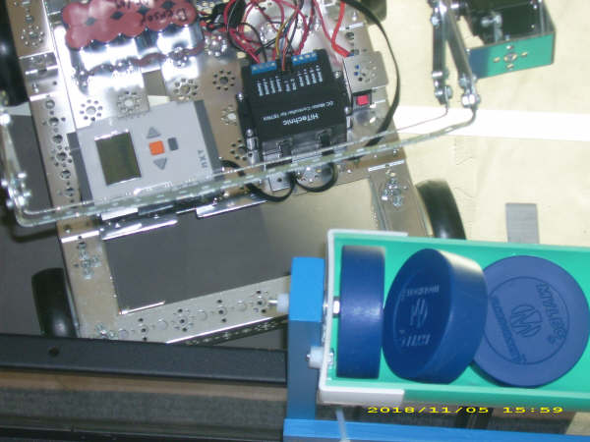
Pucks container. Motor controller on a robot. Brick.

Slide 10
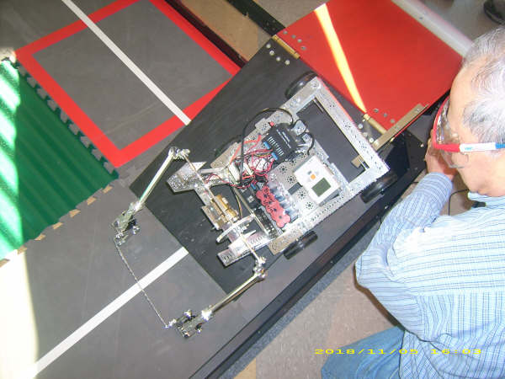
Robot from top. Note the arm to push pucks.

Slide 11
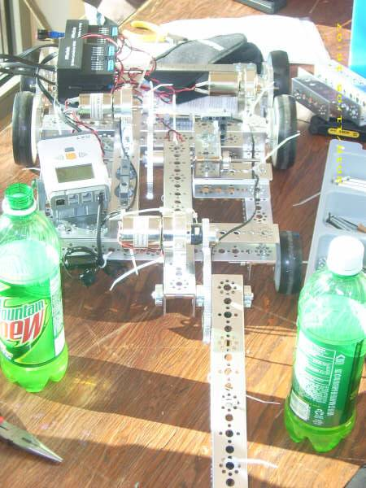
Another idea for arm construction and attachment to robot’s body

Slide 12
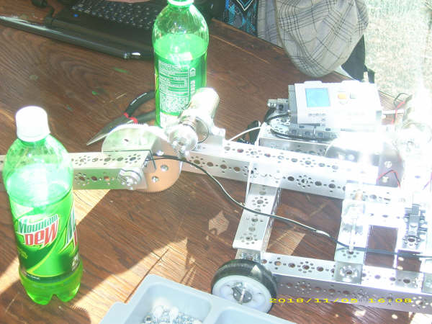
The same robot. Using DC motor on the arm

Slide 13
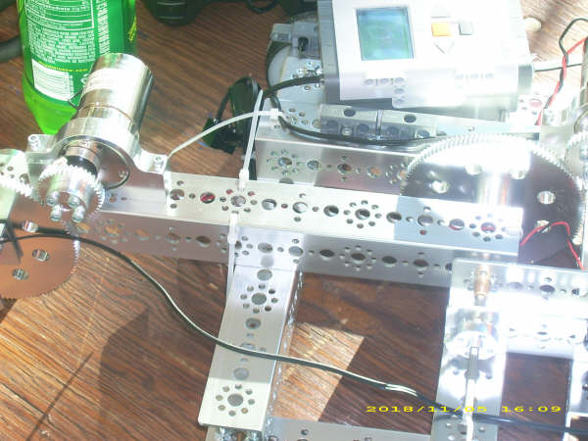
More details of the same robot

Slide 14
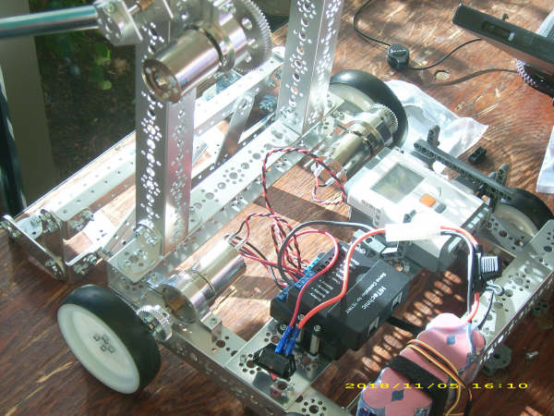
One more idea to construct the arm. Different wheel mechanism.

Slide 15
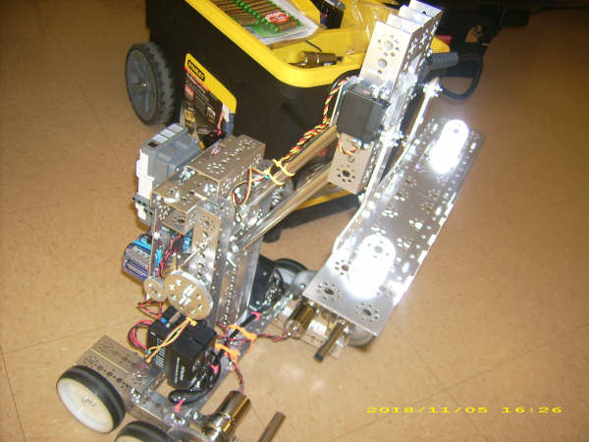
This design has lighter body and large arm. Stability problems, center of weight is high.

Slide 16
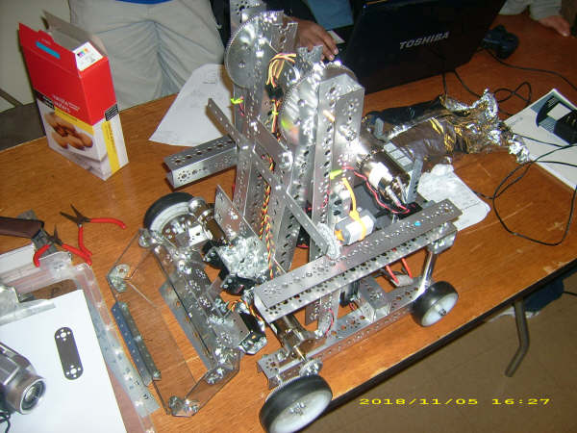
Two controls on wheels. Large arm

Slide 17
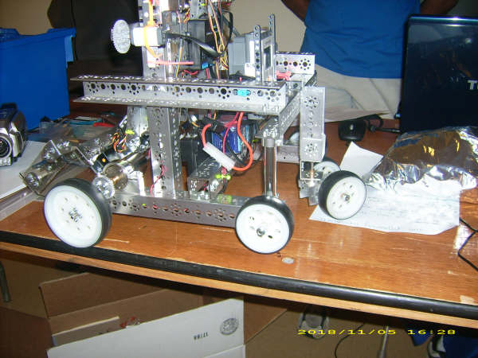
Strange design of controlled wheel plus four wheels

Slide 18
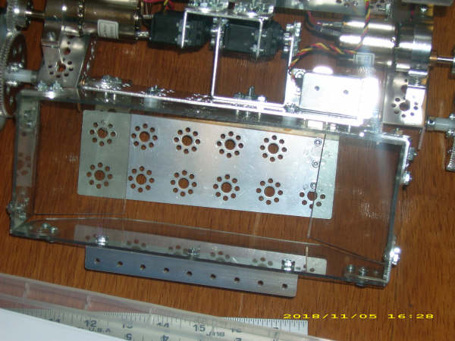
Details of puck container

Slide 19
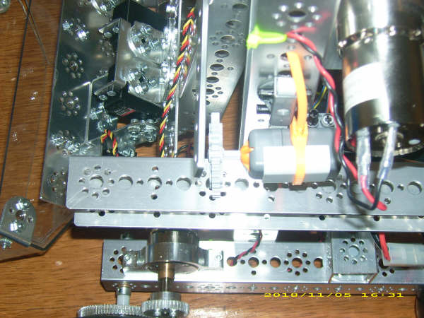

Slide 20
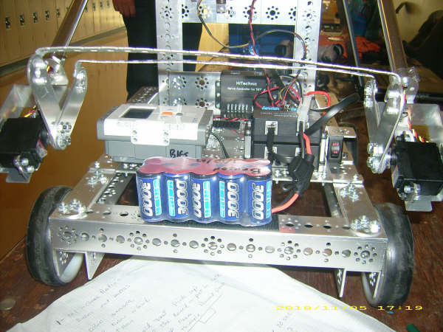
Arm construction

Slide 21
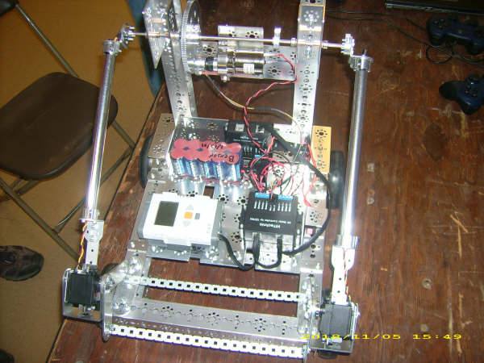
Please observe the construction of the arm.

Slide 22
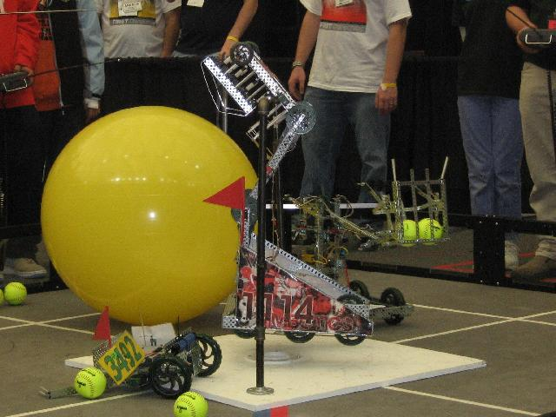
Vex robot with arm to handle tennis balls, from other competition.

